Slide 1
INTRODUCTION
NAME:NATHANIEL QUAYE BROWN.
PROJECT NAME:LIBRARY MANAGEMENT SYSTEM.
COURSE:DATABASE TECHNOLOGY 10AM-12PM.
COLLEGE: INTERCOM PROGRAMMING AND MANUFACTURING COMPANY.(IPMC)

Slide 2
TABLE OF CONTENT
INTRODUCTION………………………………………………………….……..PAGE 1.
BRIEF DESCRIPTION…………………………………………………….……...PAGE 3 .
PROBLEM DEFINITION…………………………………………………….…...PAGE 4.
BUSINESS CASE…………………………………………………………….......PAGE 5.
PROJECT PLAN………………………………………………………………....PAGE 6.
SOLUTION……………………………………………………………….............PAGE 7.
LOGICAL DIAGRAM……………………......................................................PAGE 8.
RELATIONAL DIAGRAM……………………………………………………..…PAGE 9.
DATA DEFINITION LANGUAGE…………………………………………........PAGE 10-13.
TABLE CREATION………………………………………………………………..PAGE 14-15.
INSERTING OF VALUES………………………………………………………….PAGE 16-20.
SECTION B………………………………………………………………………...PAGE 21-28.

Slide 3
BRIEF DESCRIPTION
THIS PROJECT SPEAKS OF HOW A LIBRARY IS BEEN MANAGED ,AND HOW TO KEEP RECORDS ON THE BOOKS AND WHEN THE BOOKS ARE BEEN BORROWED IN AN ENTITY RELATIONAL DIAGRAM(ERD).

Slide 4
PROBLEM DEFINITION
The library is focused on identifying the core issues that the system aims to solve .Problems like difficulty in keeping track of the accurate borrower information.

Slide 5
PROJECT PLAN
To create a computer system that will help the library staffs to operate freely and also manage the books well. It also took me three weeks to finish up with the project.

Slide 6
BUSINESS CASE
BUSINESS COST.
Our library currently uses a manual system to manage the books ,borrower information and circulation. It also enhances and improves tracking of the books and borrowers information.
Project work costs 200,000.00.
Generation of logical and relational diagram cost Ghc3,000.00.
Creation of database costs GHC120,000.00.
Overall cost 323,000.00.

Slide 7
SOLUTION
The database will help the library to make changes to database and make decisions about the books. It will also help them keep data and reduce redundancy and the amount of time spent on managing their data.

Slide 8
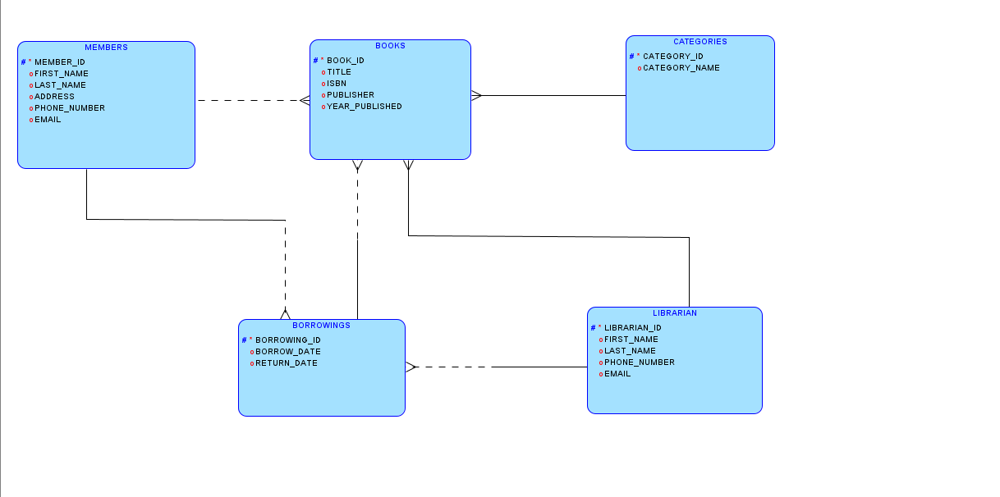
LOGICAL DIAGRAM

Slide 9
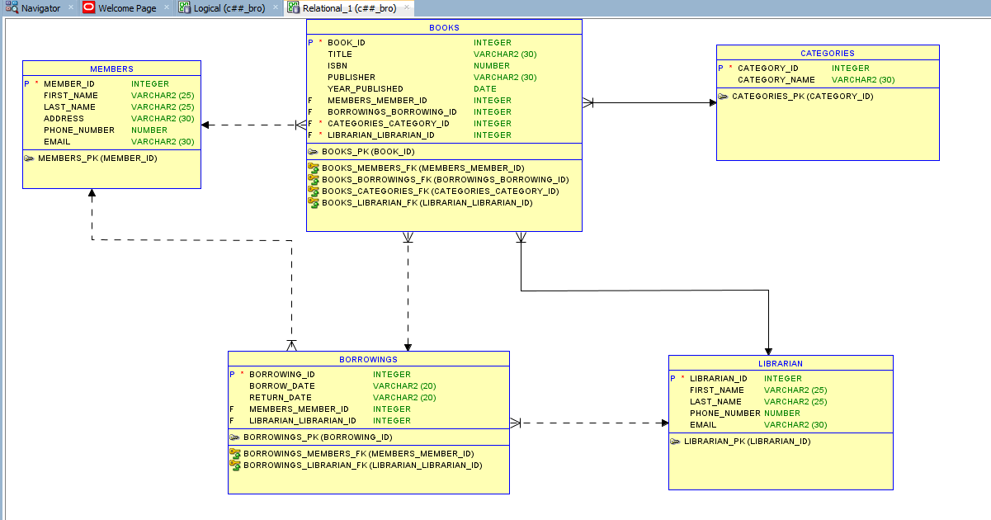
RELATIONAL DIAGRAM

Slide 10
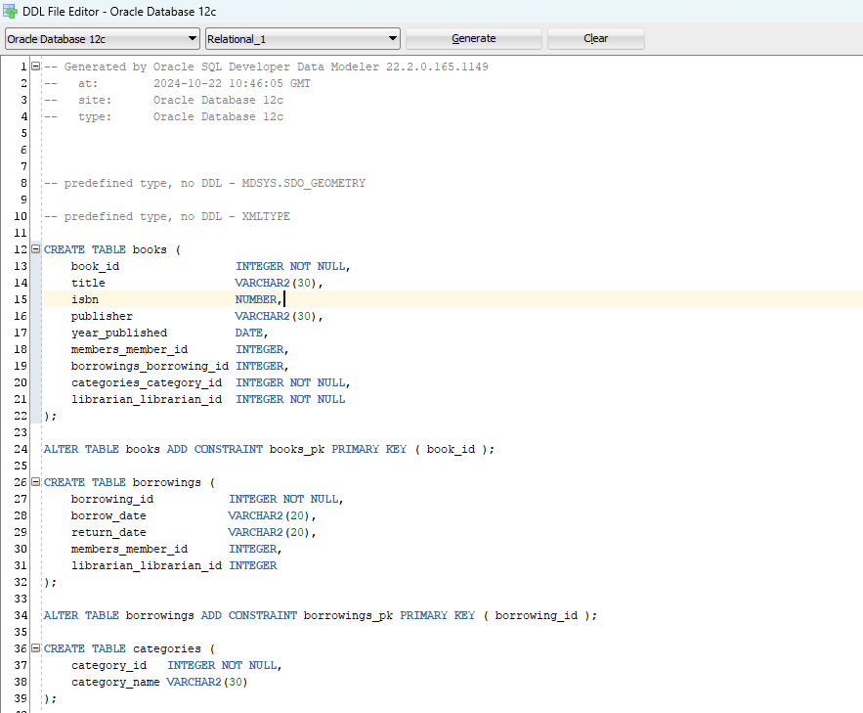
GENERATING OF DATA DEFINITION LANGUAGE USING DATA MODELAR

Slide 11
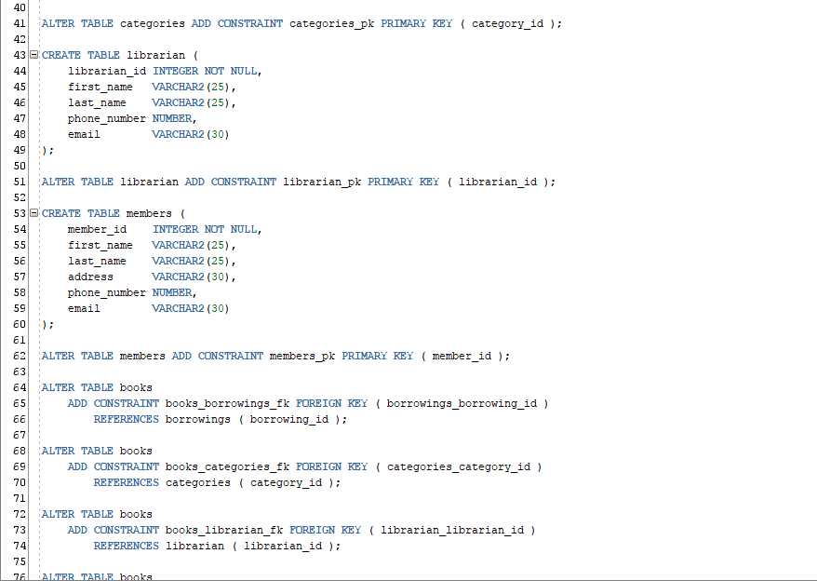

Slide 12
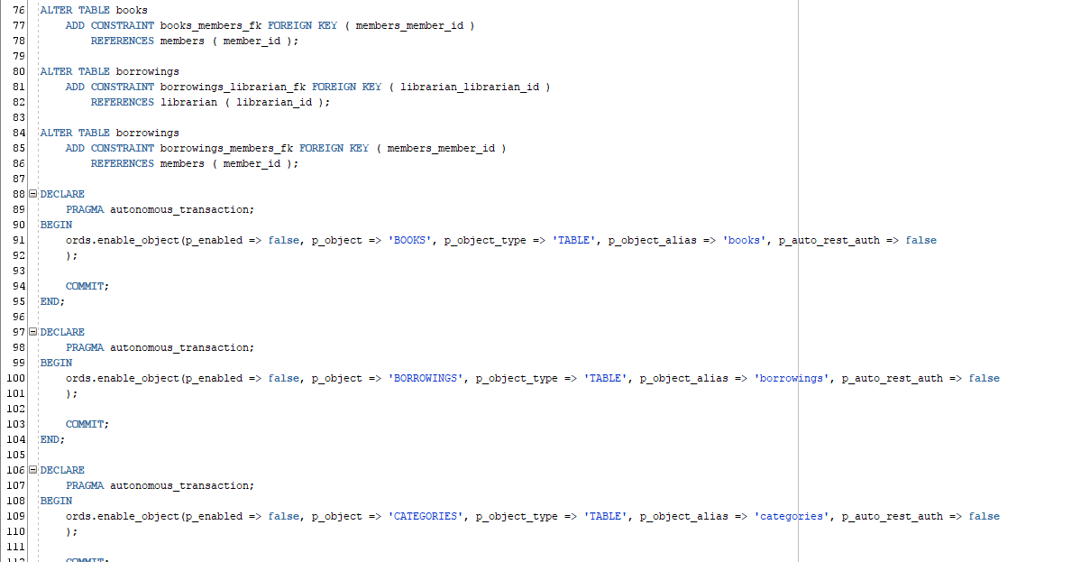

Slide 13
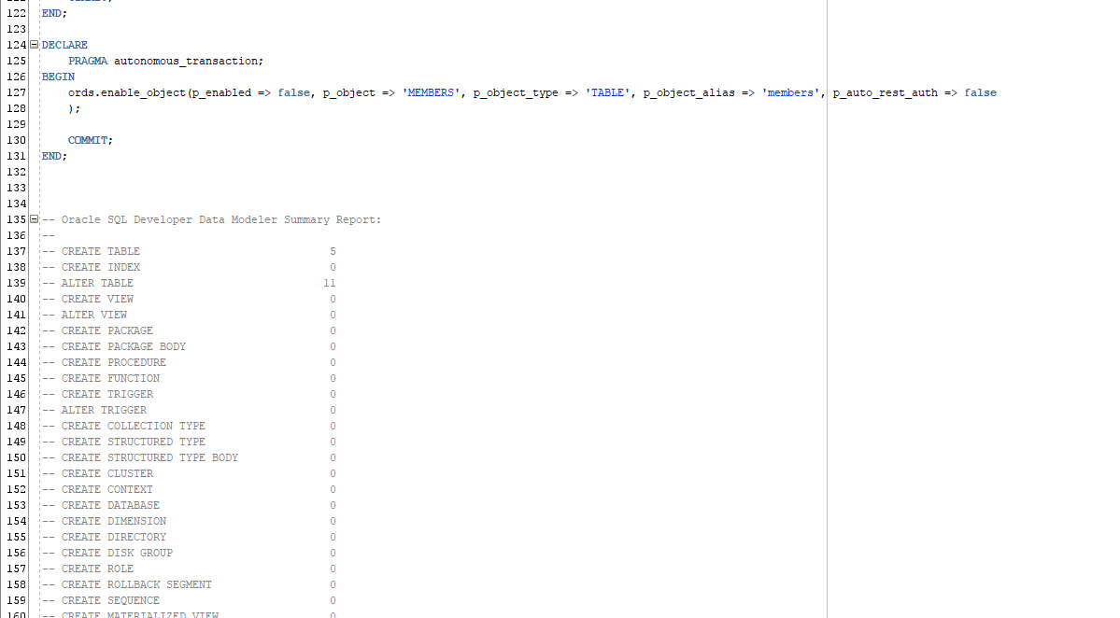

Slide 14
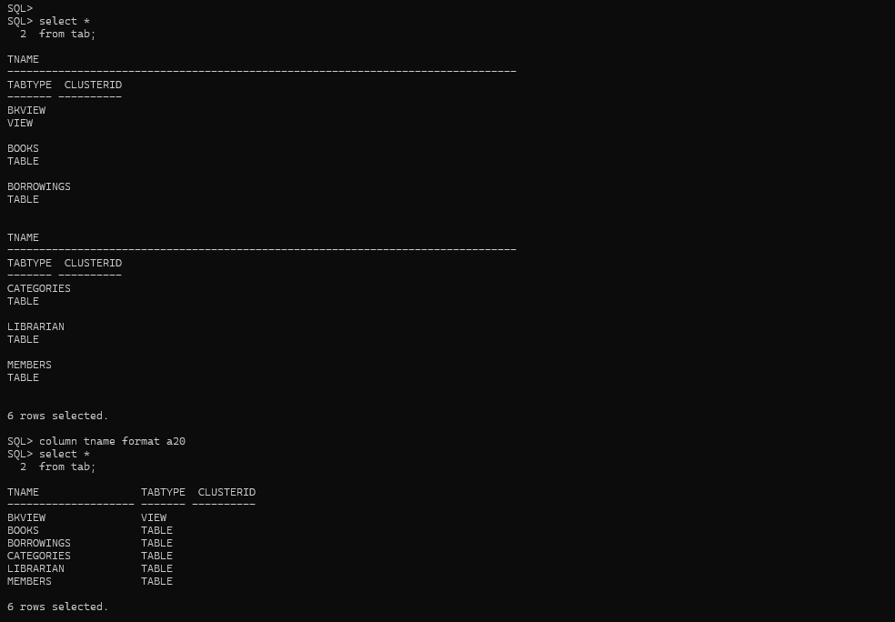
SCHEMA CREATION

Slide 15
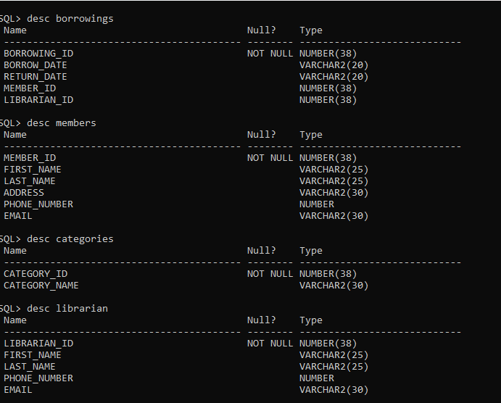

Slide 16
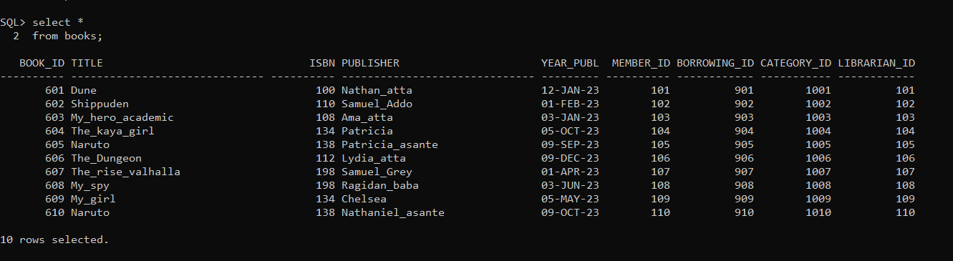
INSERTING VALUES INTO THE DATABASE

Slide 17
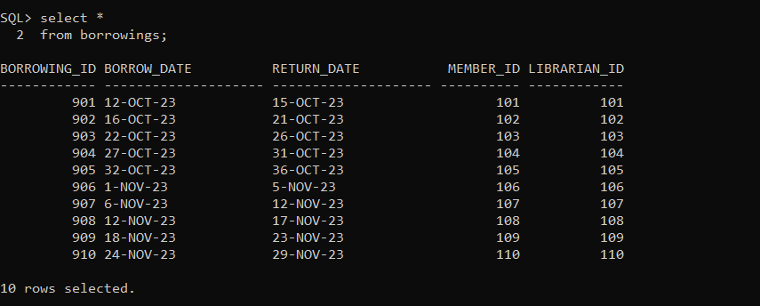

Slide 18
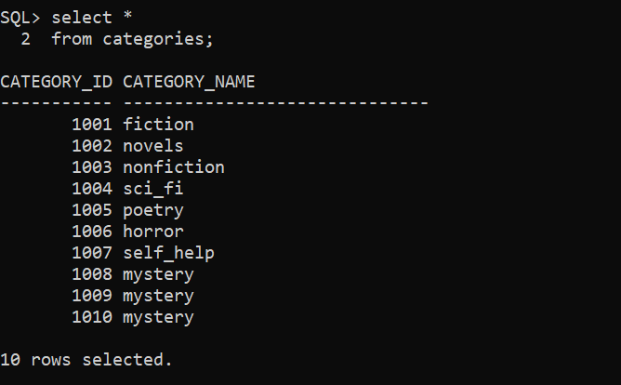

Slide 19
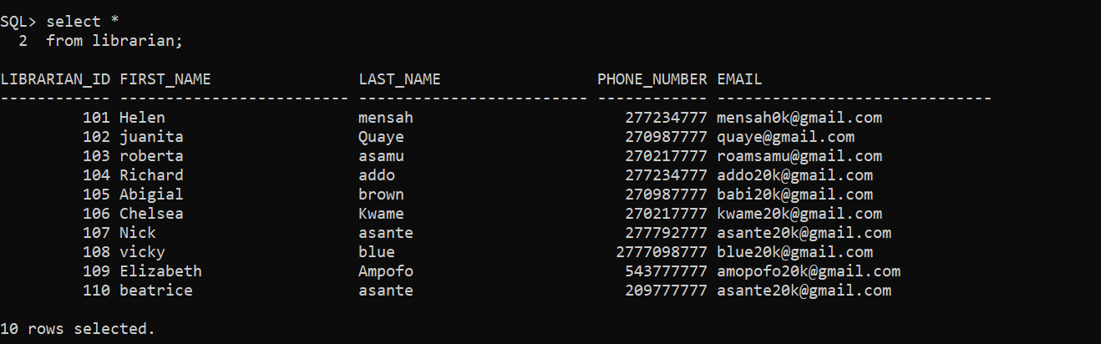

Slide 20
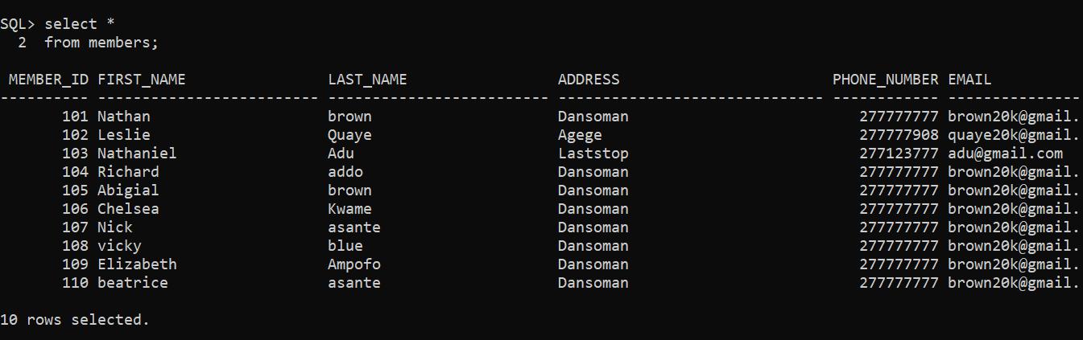

Slide 21
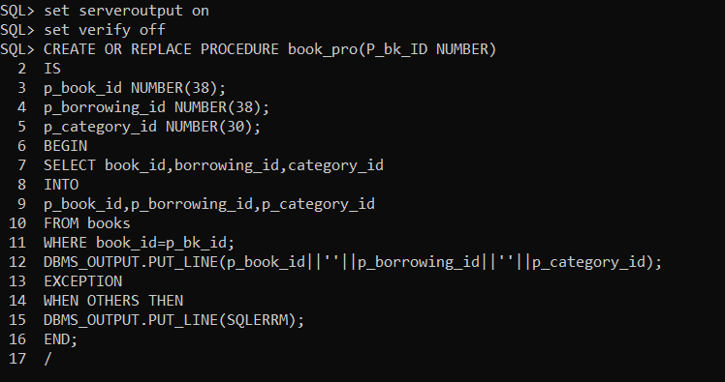
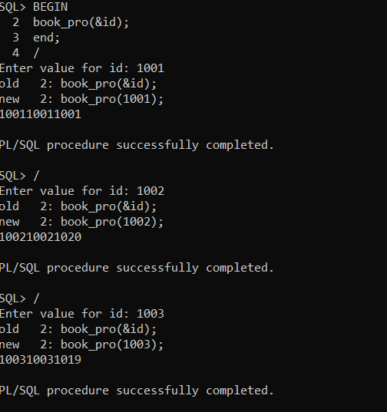
PROCEDURE DECLARATION

Slide 22
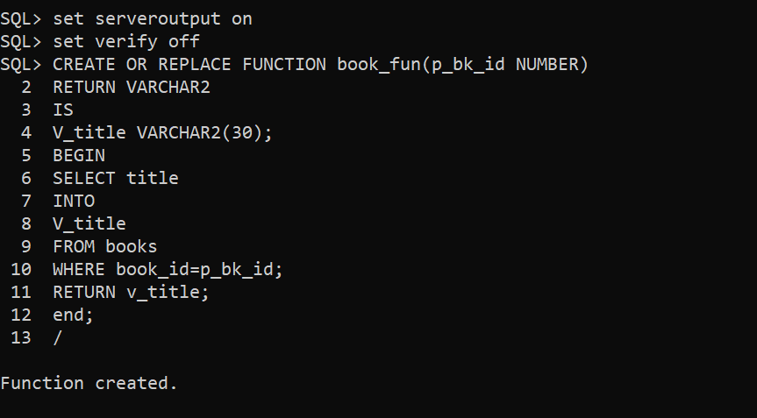
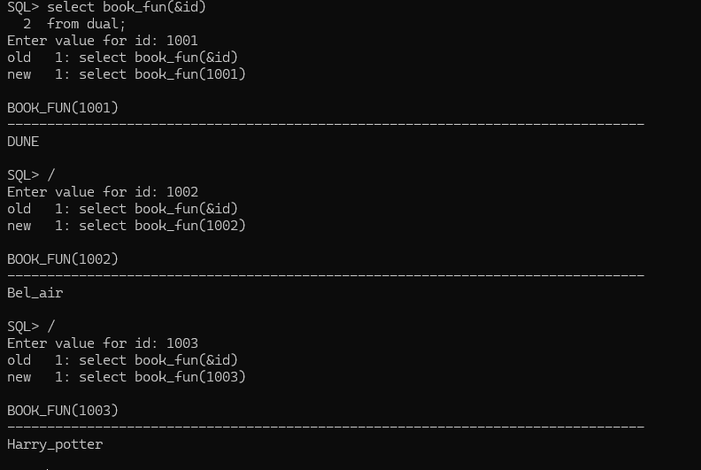
THE DECLARATION OF FUNCTION

Slide 23
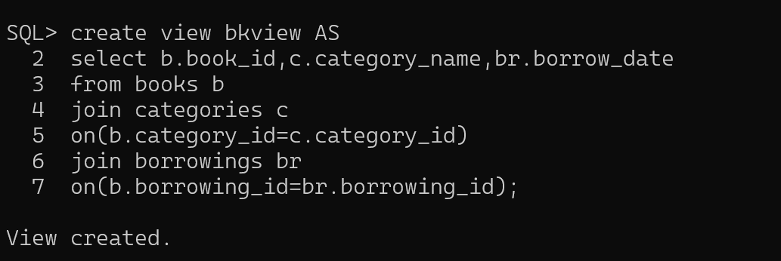
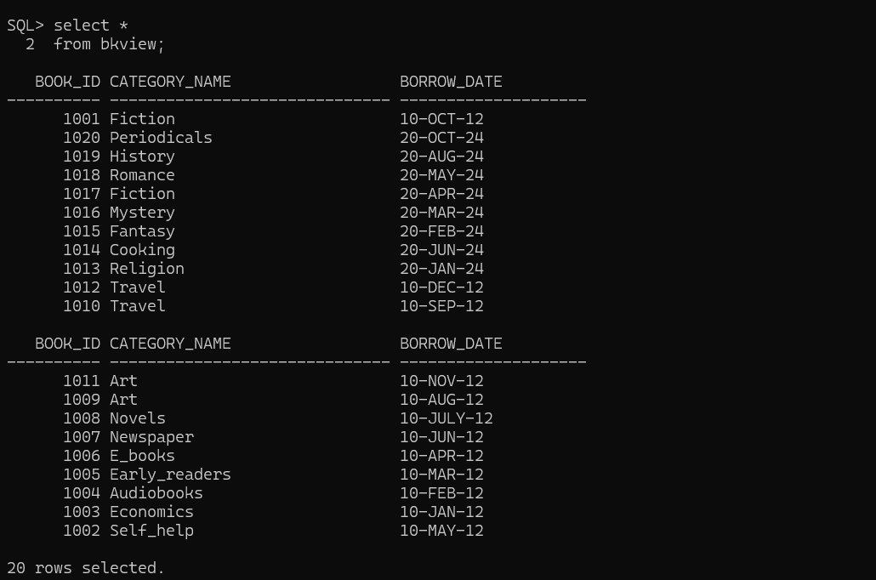
VIEW CREATION
The details of A book being borrowed

Slide 24
CONCLUSION
It will make it so easy for library management to keep good track books which was borrowed and also good track of the members information.

Slide 25
THANK YOU

